Slide 1
Lecture 12: CT Reconstruction – Deep Leaning Algorithms
Dr. Guohua Cao （曹国华） caogh@shanghaitech.edu.cn
School of Biomedical Engineering
ShanghaiTech University
4/23/2024

Slide 2
Lecture 12: CT Reconstruction – Deep Leaning Algorithms
Machine Learning/Deep Learning
Use of ML/Dl in medical imaging
DL in CT Reconstruction
Image based
Sinogram based
Dual-domain based
Sinogram-to-image
Metal artifact reduction
Outlook

Slide 3
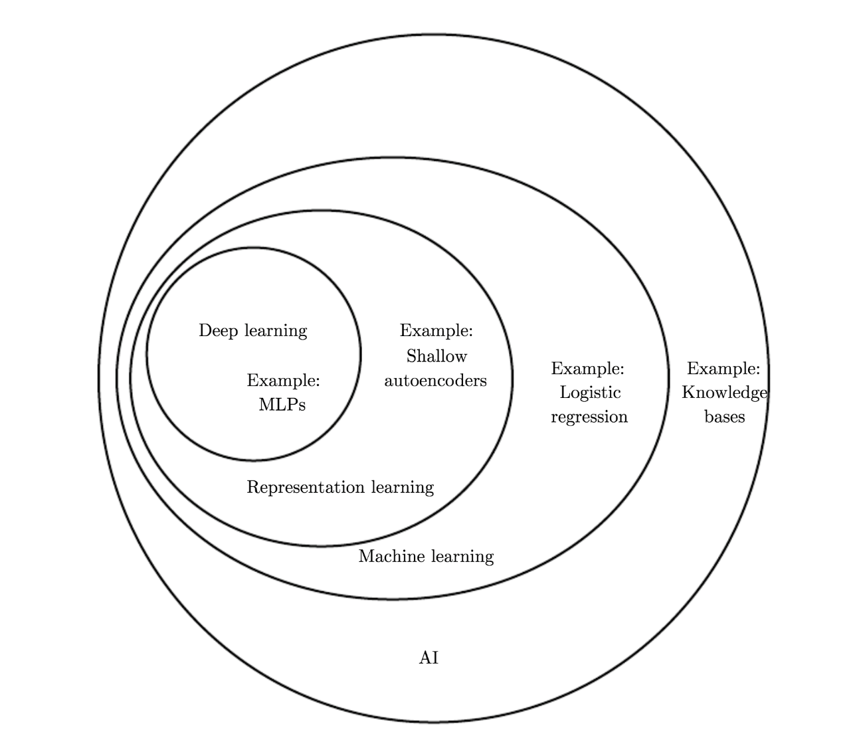
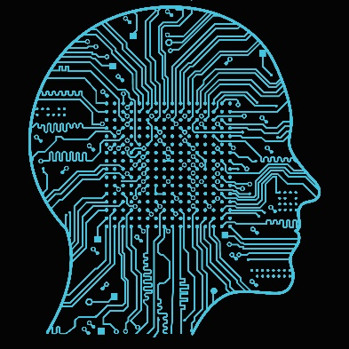
What are AI, ML, and DL?
Artificial Intelligence
General AI
Narrow AI
Machine Learning
the only kind of AI today
Deep Learning
- the (most popular) kind of ML
supervised learning
unsupervised learning
“Don't model the World; Model the Mind.”

Slide 4
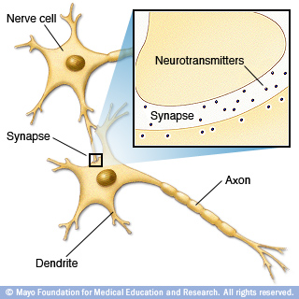
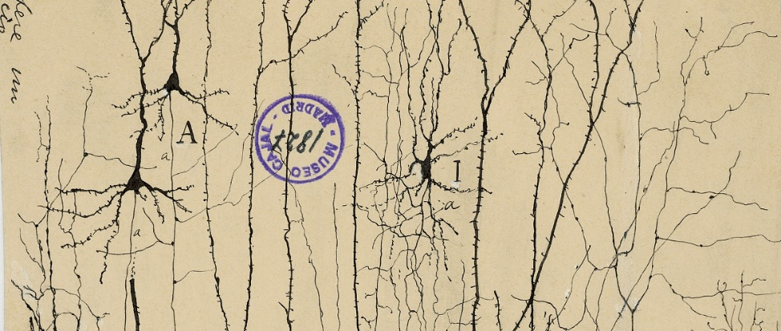
Intelligence and Neural Network
in·tel·li·gence
- (noun) the ability to acquire and apply knowledge and skills
Human Neuron and Neural Network
- about 100 billion neurons (not largest, elephant has 3X more neurons)
- about 100 trillion neural connections (aka. synapses, the largest known)
One of the first drawings of neural network by
Santiago Cajal,1906 Nobel prize in physiology & medicine
Two neurons connected by synapses.

Slide 5
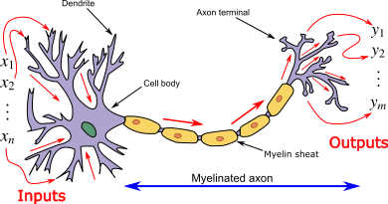
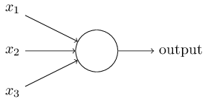
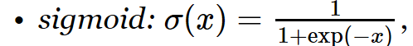
Biological Neuron and Artificial Neuron
Biological Neuron –
the building block of biological NN
Artificial Neuron
- the building block of DL NN
Output: y = σ(w⋅x+b),
σ - activation function of the "neuron“,
w, b – network parameters.
w1, b1
w2, b2
w3, b3

Slide 6
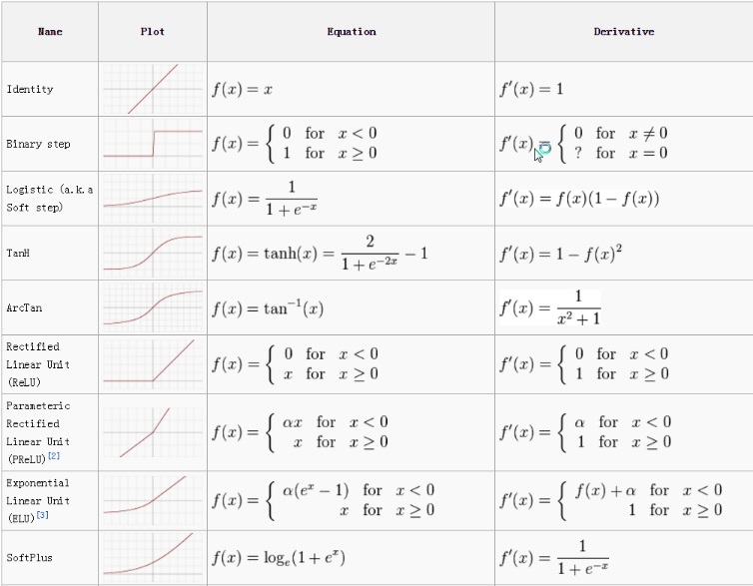
Activation Function

Slide 7
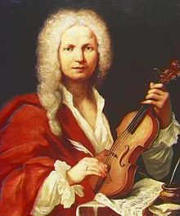
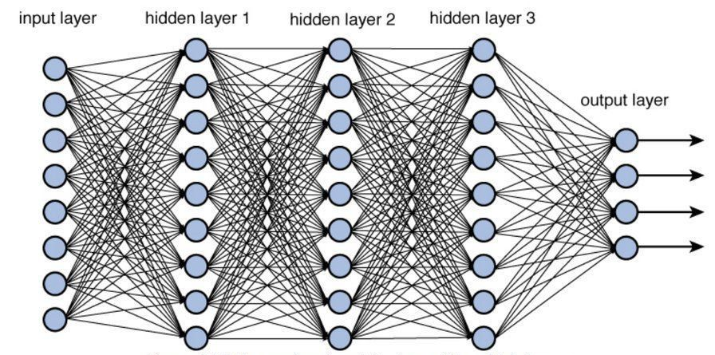
Learning with Neural Network
Every expertise requires 10,000 hours of practice (i.e. 10 years if 4 hour practice every day).
E.g. learning violin: beginner, intermediate, advanced, professional, virtuoso.
Best DL requires (repetitive) training with LARGE data!
Antonio Vivaldi (violin virtuoso)
Y = σW⋅X
DATA
Notes:
The goal is to learn W, the weighting coefficients, aka. network parameters. Like biological neural connections, stronger and thicker connections indicate large weighting coefficients.

Slide 8
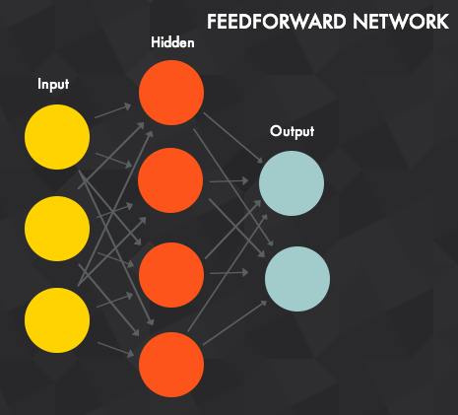
Universal Approximation Theorem
1. The universal approximation theorem states that feedforward neural networks (a neural network with one hidden layer) constructed of artificial neurons can approximate real-valued continuous functions (for inputs within a specific range), to arbitrary accuracy.
2. Neural networks can in principle be applied to nearly any problem, as they can approximate essentially any function.
3. Any physical process, such as an imaging process, can be represented as a continuous function.
4. Therefore, neural networks can be used to approximate/model any process in medical imaging.

Slide 9
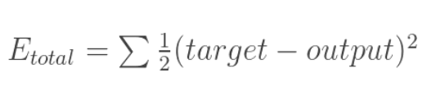
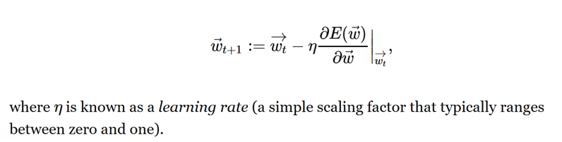
How neural network learn?
Training data (w. at least one sample)
Loss function (aka. cost function, objective function, target function, error function)
Learning is an optimization problem, that is, finding the best solution, iteratively, from all training data.
Optimization problem:
Objective Function
Parameter Refinement

Slide 10
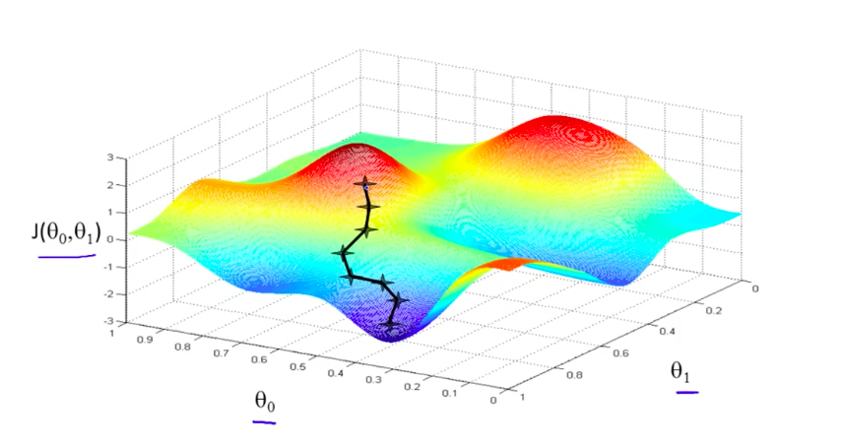
DL training is similar to Gradient Descent Search

Slide 11
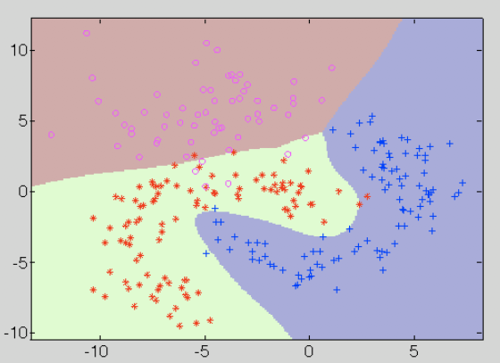

Fitting/Clustering

Slide 12
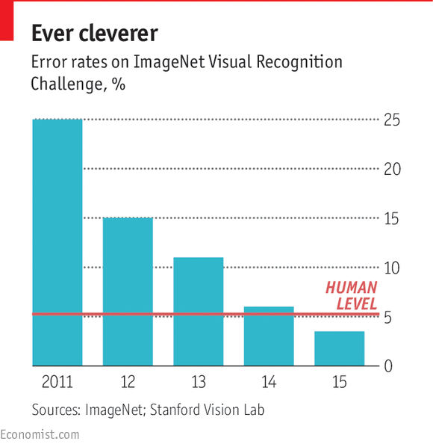
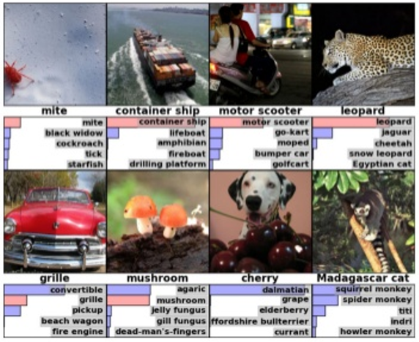
ImageNet Contest

Slide 13
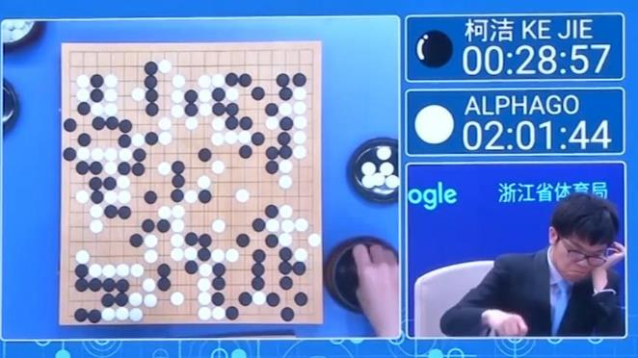
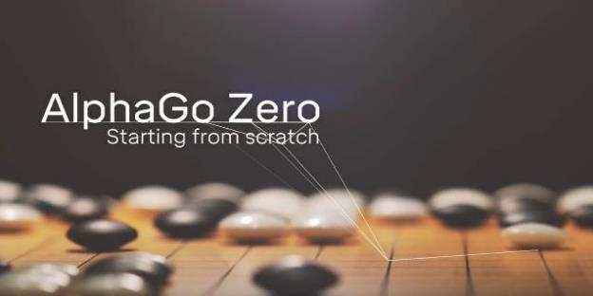
AlphaGo

Slide 14
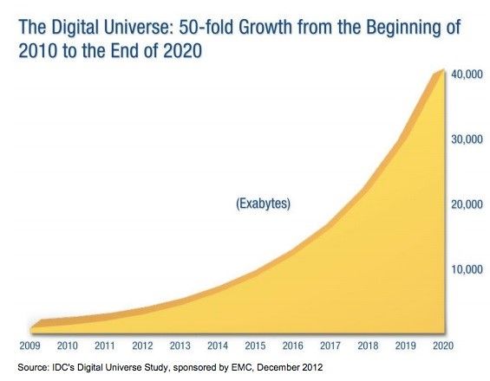
Exp Growth of Data Size

Slide 15
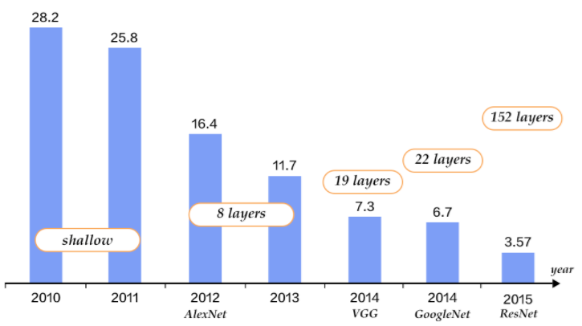
Exp Growth of Depth/Complexity
Top-5 Error Rate
If the correct answer is among the top 5 guesses, it is said in Top-5; otherwise, it is considered as an error
http://book.paddlepaddle.org/03.image_classification/

Slide 16
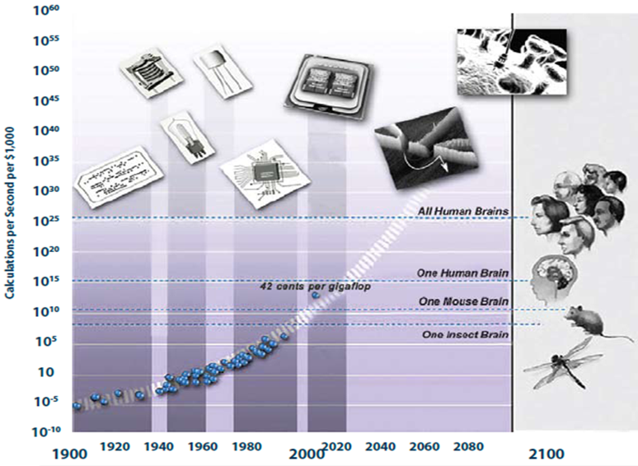
Exp Growth of Computing Power

Slide 17

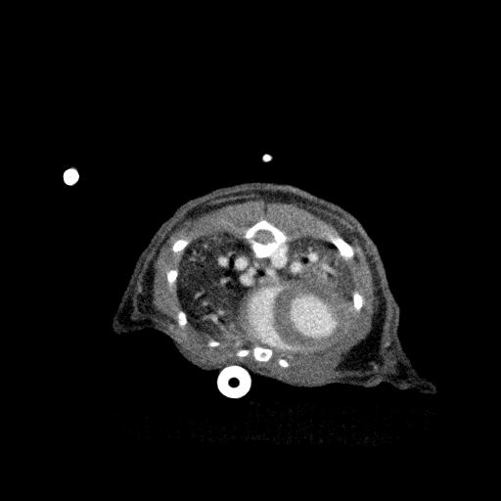
CT Reconstruction: Sinogram to Image
Sinogram
CT image
Algorithm | Speed | Quality
Analytical | ✓ | ✗
Iterative | ✗ | ✓
Deep-learning | ✓ | ✓

Slide 18
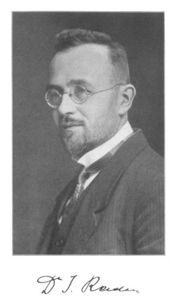
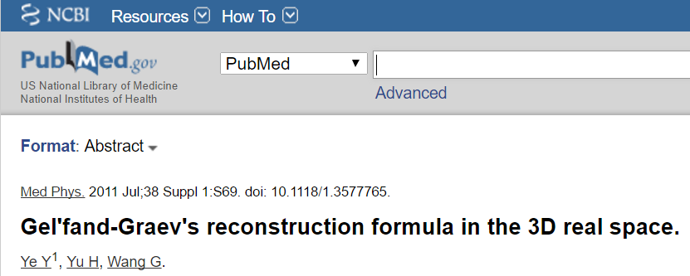
Analytic Approach
The Radon transform is based on integration over hyperplanes, “thoroughly” studied.

Slide 19
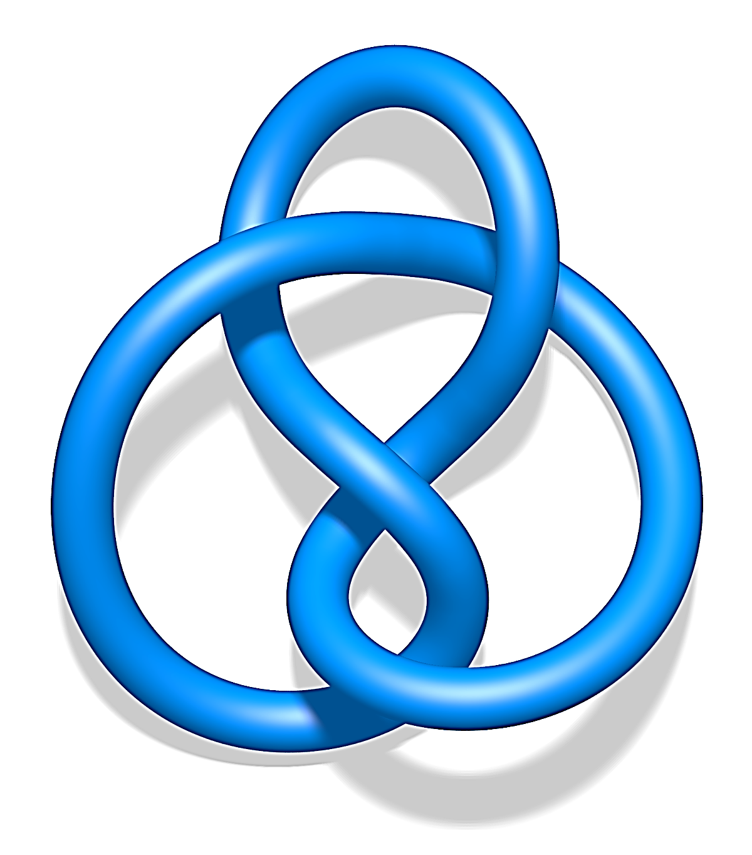
Iterative Approach
Least Square
Maximum Likelihood (ML)
Maximum A Posteriori (MAP)
Non-negativity
Maximum Entropy
Roughness Penalty
Minimum Total Variation (MTV)
Low Rank
Dictionary Learning
Low-dimensional Manifold
… …

Slide 20
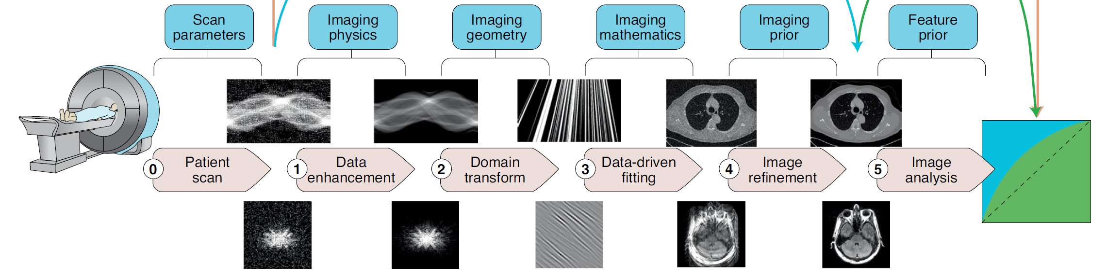
DL can be used in the full train of medical imaging
Patient
Diagnosis

Slide 21
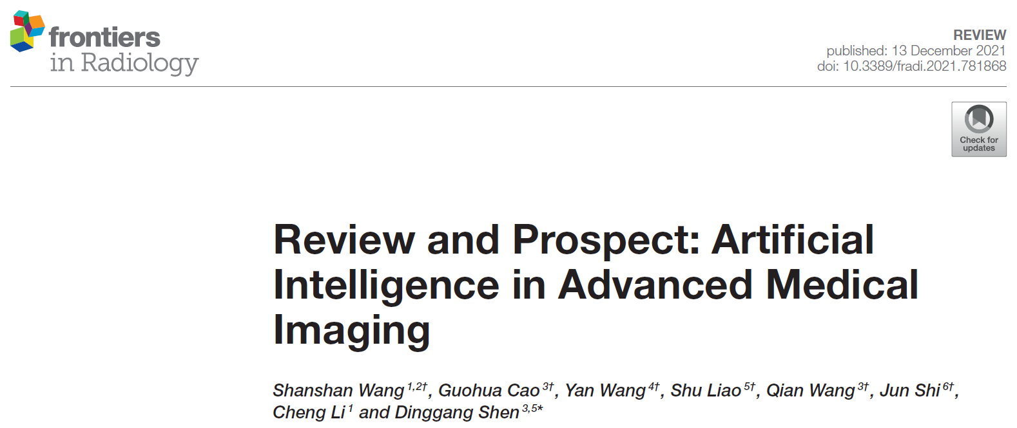
Shanshan Wang, Guohua Cao, Yan Wang, Shu Liao, Qian Wang, Jun Shi, . . . Dinggang Shen, "Review and Prospect: Artificial Intelligence in Advanced Medical Imaging". Frontiers in Radiology 1 (2021).

Slide 22
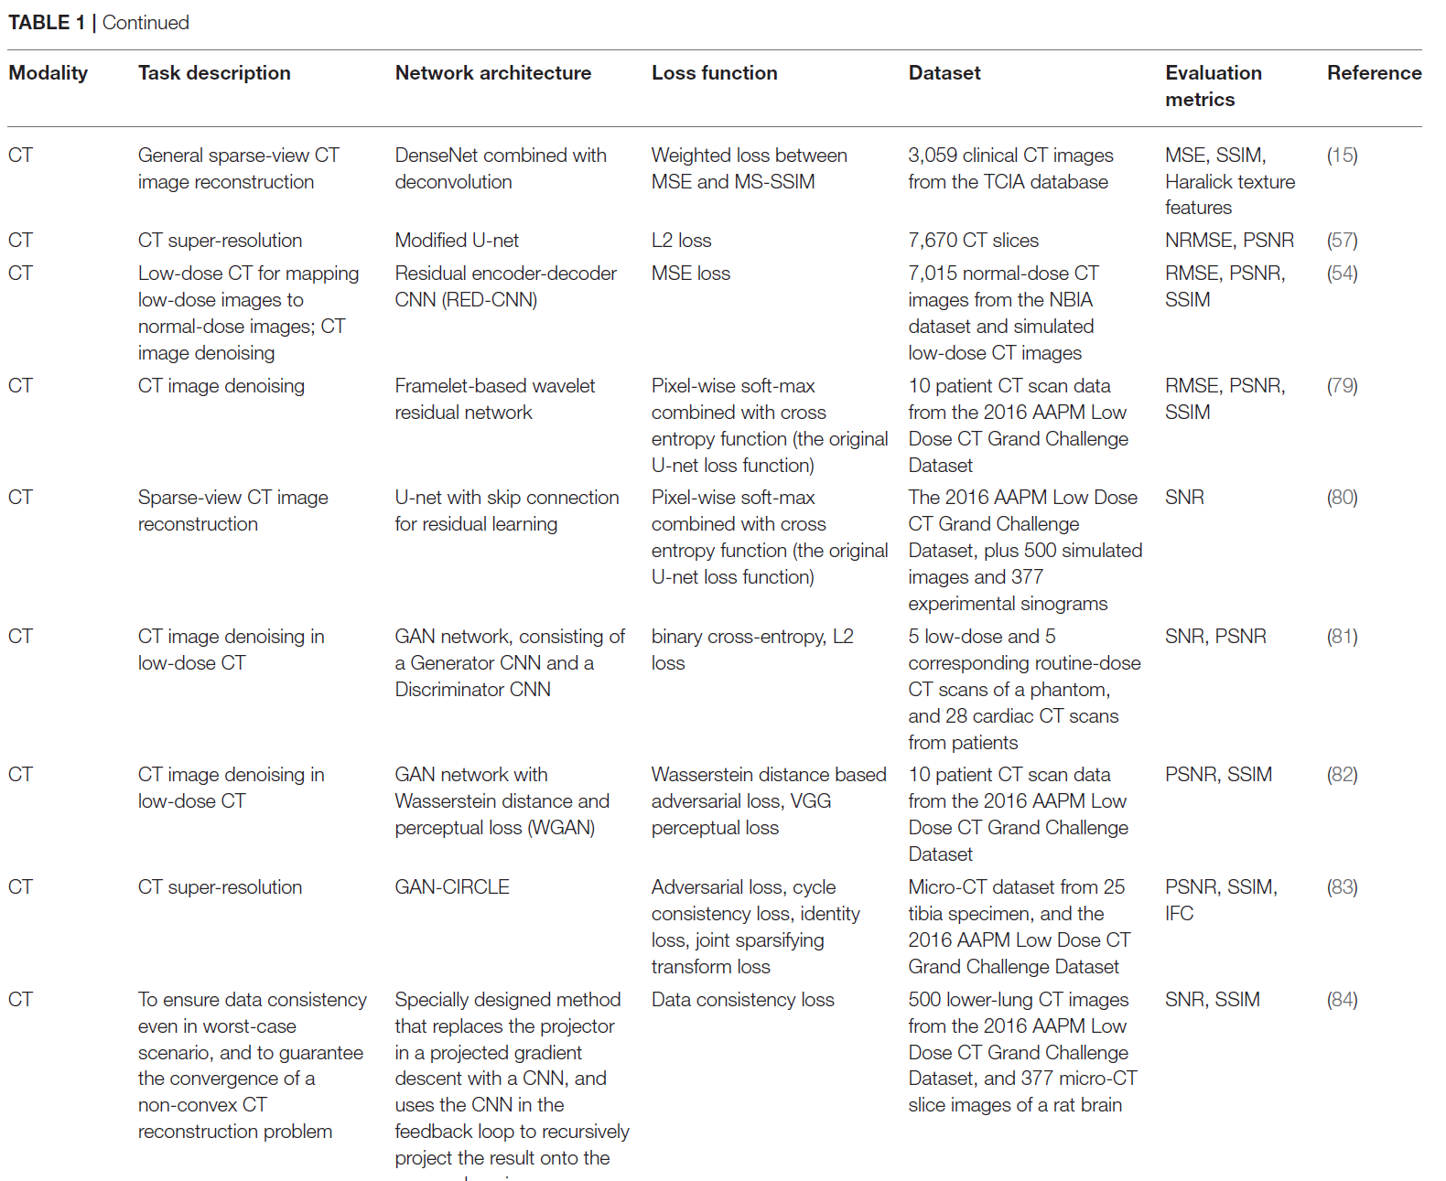

Slide 23
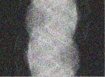
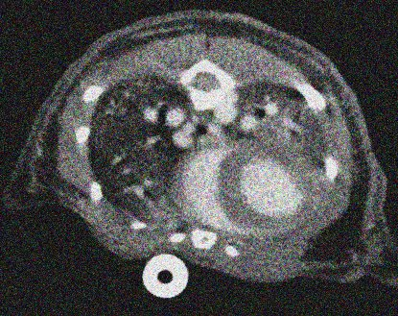
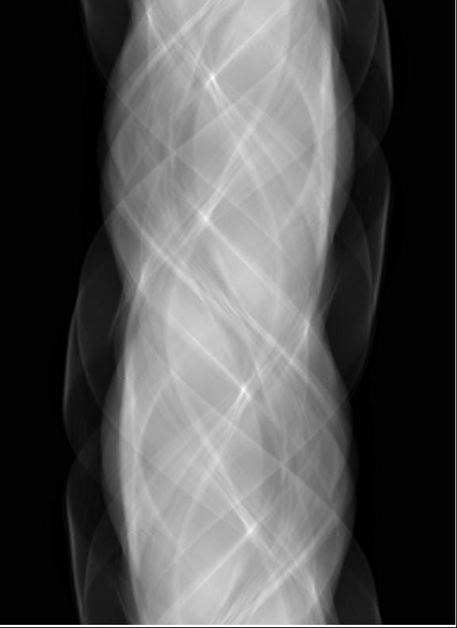
Deep Learning Reconstruction
Sinogram
Image
Sinogram
CT image

Slide 24
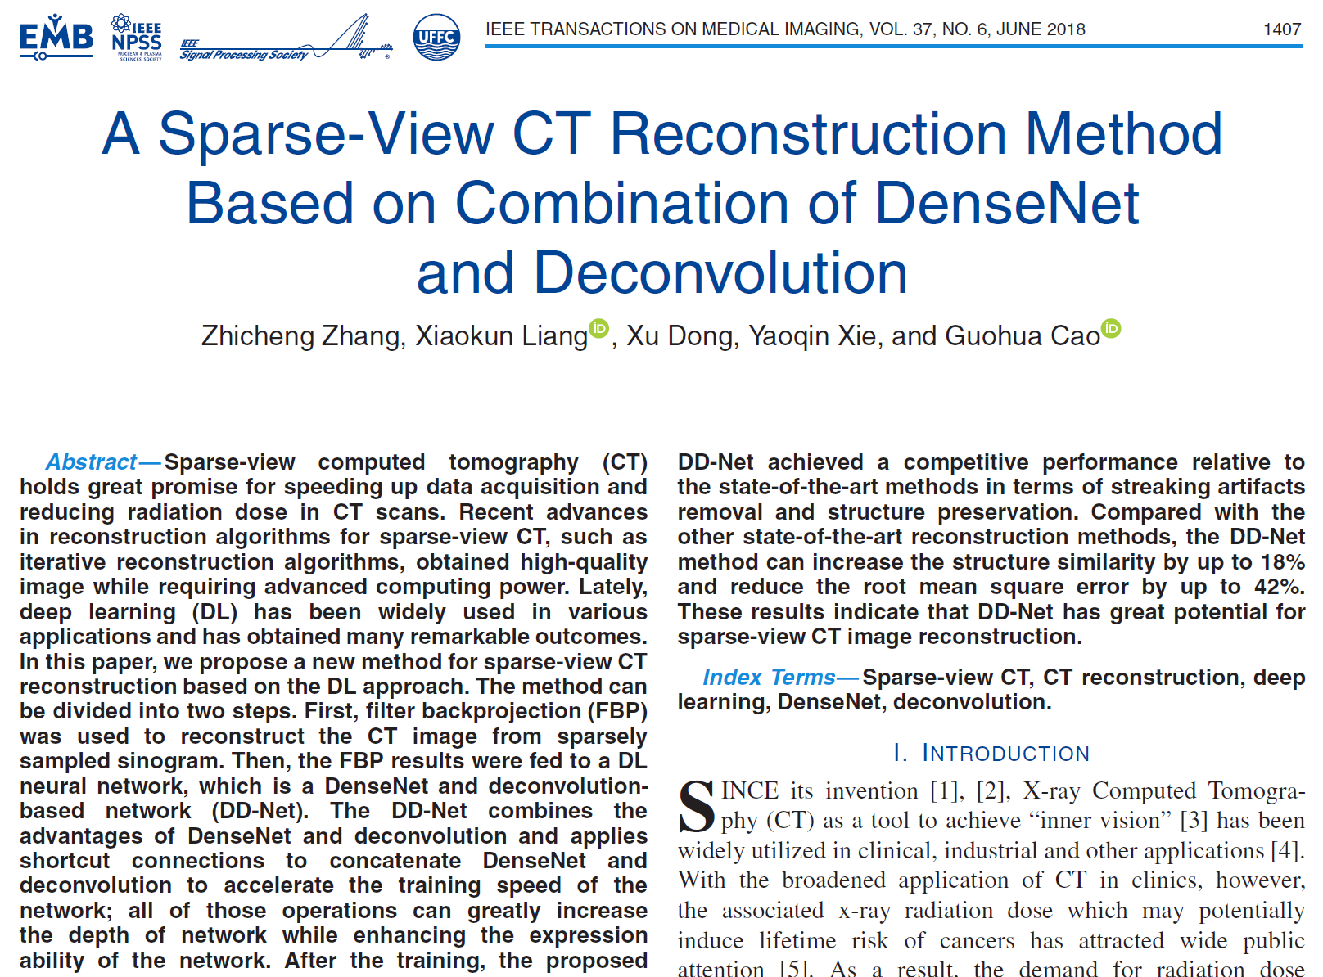
Post-Processing: Image to Image

Slide 25
DD-Net: Sparse-view CT Reconstruction
120 views
(A) Original image, (B) FBP, (C) PWLS-TGV, (D) R-NLTV, (E) DD-Net.
Z. Zhang, …, G. Cao*, IEEE TMI (2018)
Zhicheng Zhang, Xiaokun Liang, Xu Dong, Yaoqin Xie, and Guohua Cao, "A Sparse-View CT Reconstruction Method Based on Combination of DenseNet and Deconvolution". IEEE Trans Med Imaging 37(6): p. 1407-1417 (2018).
X. Dong, G. Cao*, SPIE-Medical Imaging (2019)
Notes:
Supervised learning

Slide 26
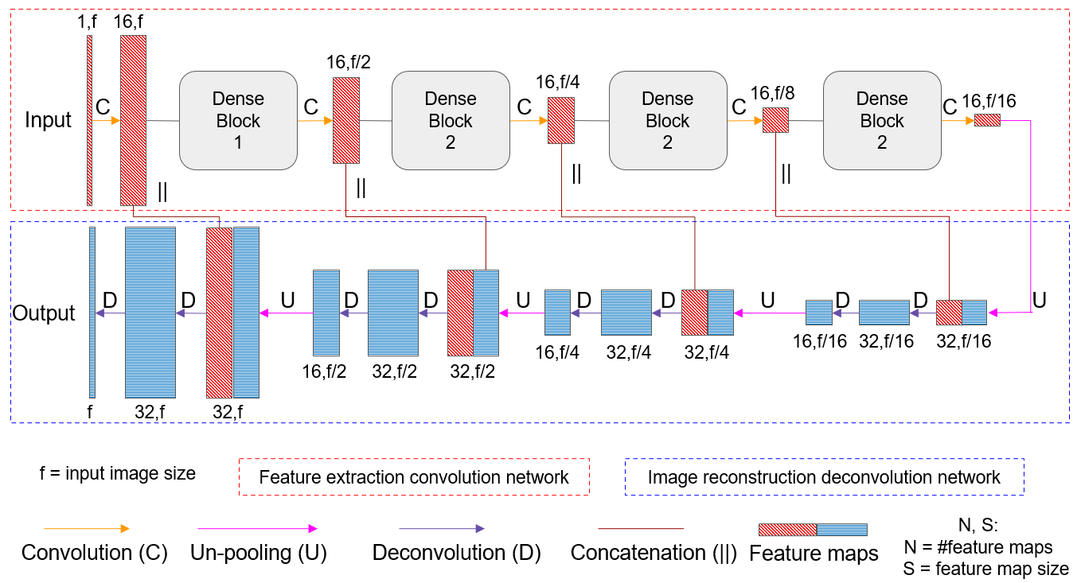
DD-Net: DenseNet + Deconvolution
DenseNet
Deconvolution network

Slide 27
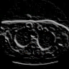
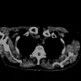
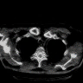
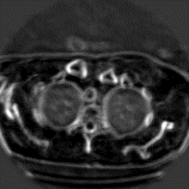
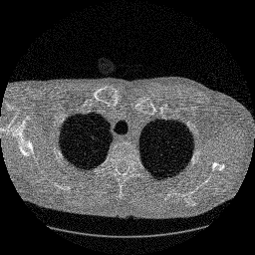
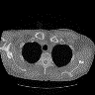
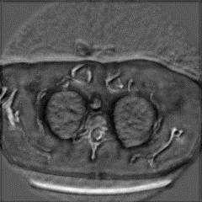
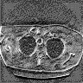
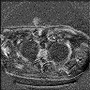
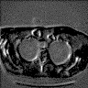
RED-CNN: CT Denoising
Encoder
Convolutional
De-conv
Decoder
ReLU
H. Chen, Y. Zhang, M. K. Kalra, F. Lin, Y. Chen, P. Liao, . . . G. Wang, "Low-Dose CT With a Residual Encoder-Decoder Convolutional Neural Network". IEEE Trans Med Imaging 36(12): p. 2524-2535 (2017).

Slide 28
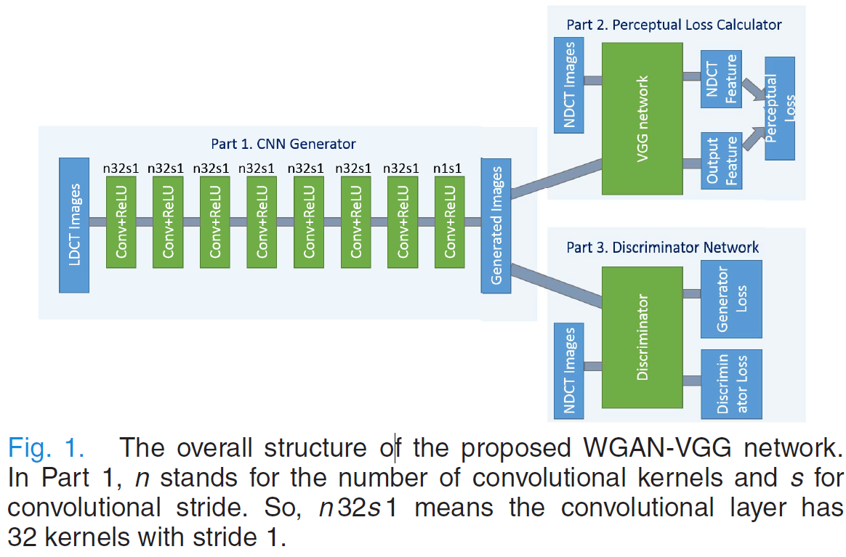
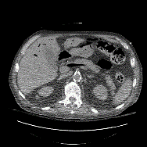
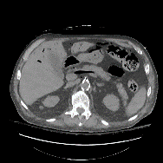
WGAN-VGG: CT Denoising
Q. Yang, P. Yan, Y. Zhang, H. Yu, Y. Shi, X. Mou, . . . G. Wang, "Low-Dose CT Image Denoising Using a Generative Adversarial Network With Wasserstein Distance and Perceptual Loss". IEEE Trans Med Imaging 37(6): p. 1348-1357 (2018).
Notes:
FBP: photon starvation artifacts in lower part, nodule near the right kidney is limited

Slide 29
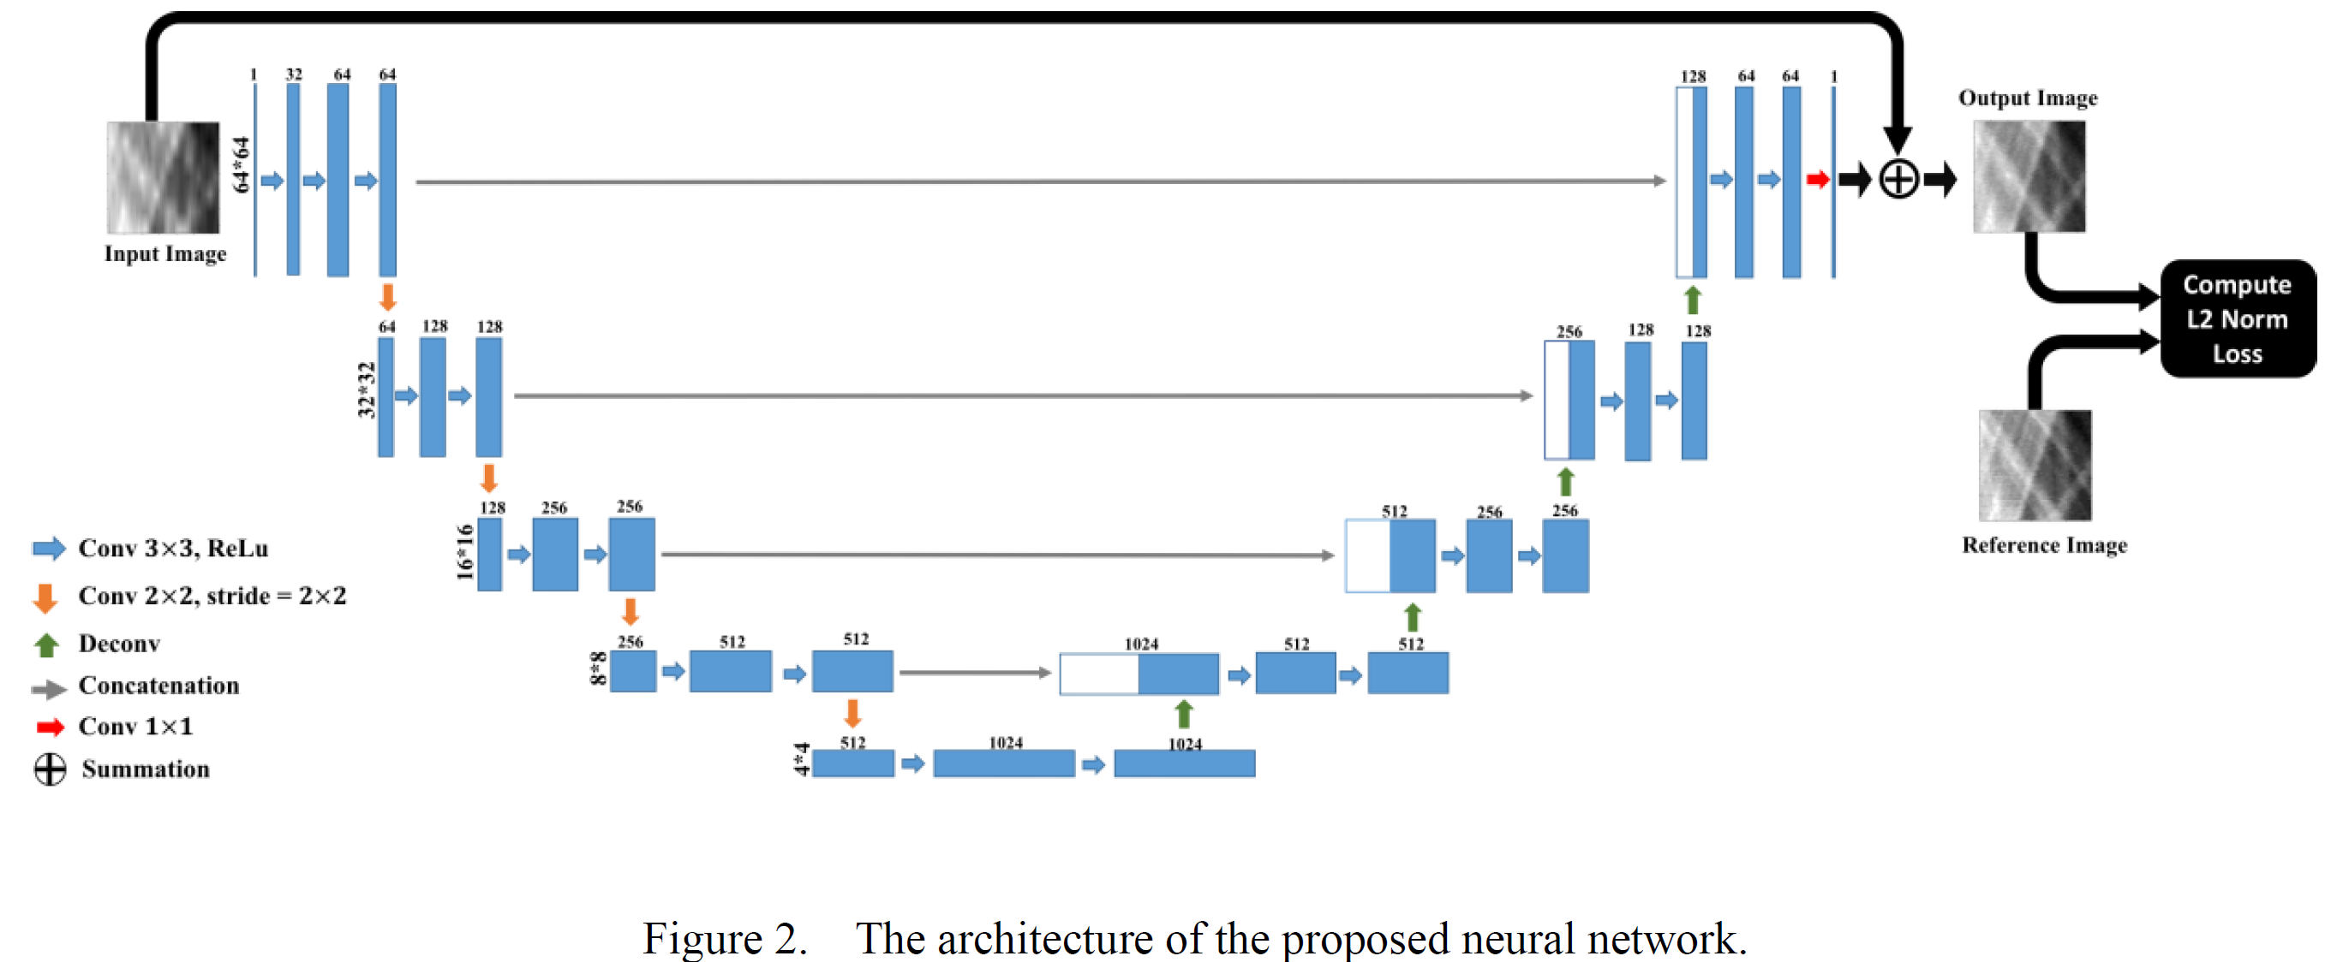
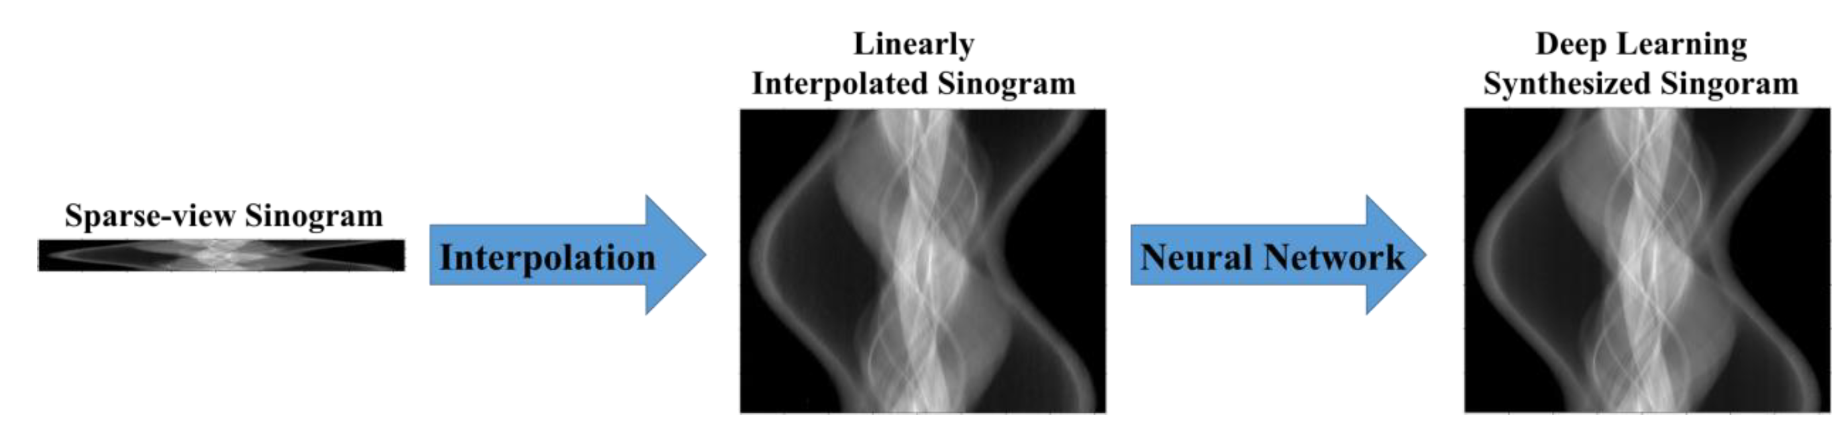
Pre-Processing: sinogram to sinogram
Sparse-view CT Recon
Xu Dong, Swapnil Vekhande, and Guohua Cao. "Sinogram interpolation for sparse-view micro-CT with deep learning neural network". Medical Imaging 2019: Physics of Medical Imaging, 10948: p. 109482 International Society for Optics and Photonics (2019).

Slide 30
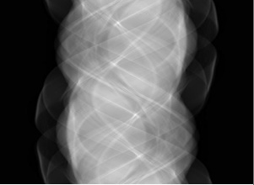


DRONE: dual-domain Reconstruction
W. Wu, D. Hu, C. Niu, H. Yu, V. Vardhanabhuti, and G. Wang, "DRONE: Dual-Domain Residual-based Optimization NEtwork for Sparse-View CT Reconstruction". IEEE Trans Med Imaging 40(11): p. 3002-3014 (2021).

Slide 31












LEARN: sinogram to image (end-to-end recon)
Under-sampled Data
Reconstruction
…
…
1st
2nd
t-th
(T-1)-th
T-th
Iteration-inspired Layer
Conv+ReLU
Conv

Slide 32
SADIR: Self-supervised Reconstruction
Zhicheng Zhang, Shaode Yu, Wenjian Qin, Xiaokun Liang, Yaoqin Xie, and Guohua Cao, "Self-supervised CT super-resolution with hybrid model". Computers in Biology and Medicine 138: p. 104775 (2021).

Slide 33
SADIR: sinogram-to-image CT super-resolution

Slide 34

Metal Artifact Reduction

Slide 35




Smart Interpolator
True Image with
Metal Implant
True Data with Metal Trace
Reconstructed via
Deep Learning
Learned Data Eliminating Metal Trace

Slide 36

CNN based Metal Artifact Reduction
Y. Zhang and H. Yu, "Convolutional Neural Network Based Metal Artifact Reduction in X-Ray Computed Tomography". IEEE Trans Med Imaging 37(6): p. 1370-1381 (2018).

Slide 37


Summary on Deep Recon

Slide 38



Rawdiomics – w. deep learning, radiology w/o images
Past
Normal Dataset
Analytic Recon
Crafted Features
Statistical Model
Present
Low-dose Dataset
Iterative Recon
CNN-based Features
Trained Network
Future
Low-dose Dataset
FBP Network
Improvement Network
Recon Image
ROI Segmentation
Deep Features
Final Diagnosis
Deep Recon
Rawdiomics
Deep Radiomics

Slide 39

Smart Medicine
Ge Wang, "A Perspective on Deep Imaging". IEEE Access 4: p. 8914-8924 (2016).

